Slide 1
GloBox A/B Testing
Author: Kalaivani Sankaralingam
Date: 28-08-2023

Slide 2
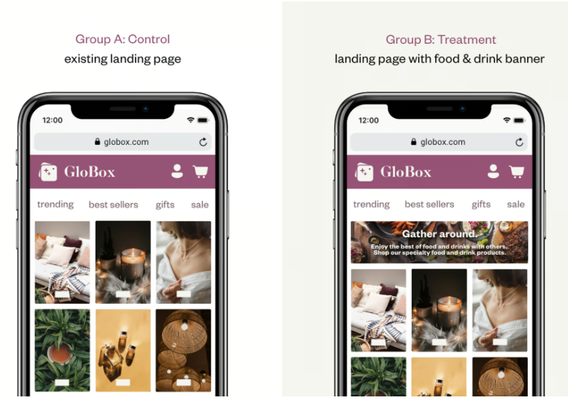
New Homepage design
Goal - Increasing the revenue
A/B Test - Comparing 2 versions of the product

Slide 3
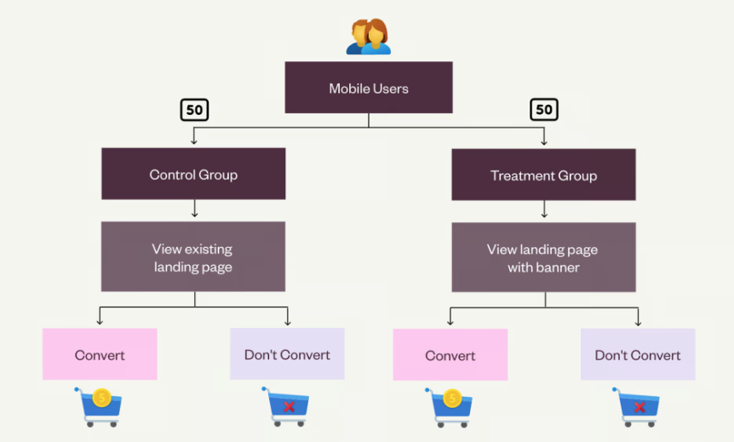
A/B Test Setup
Only for mobile devices.
Tested with 48943 users
Users are randomly assigned to each group.
Treatment group users will see the home page with banner.
The user who is making the purchase is considered as “Converted”.

Slide 4
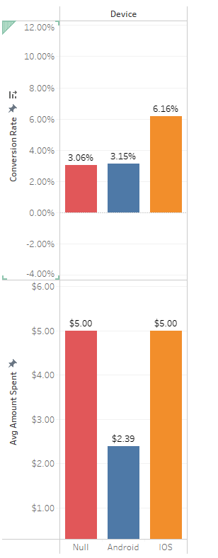
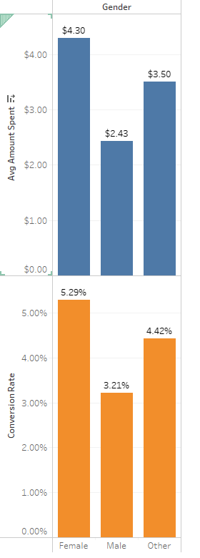
A/B Test
We have conducted numerous tests with the new home page design to see if it would increase revenue.
Some sample tests that have been carried out are:
Average of converted users and Average spending amount of converted users categorized by
Gender
Device
Country

Slide 5
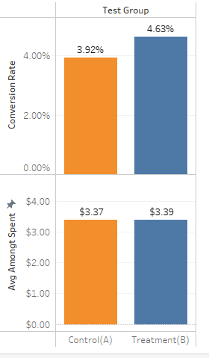
Average amount spent per user
24343 users in the Control group and 24600 users in the Treatment group.
The average amount spent per user – Control vs. Treatment.
The treatment group had approximately equal revenue
for a small sample size.
Uplift of 0.71% in conversion rate.

Slide 6
Recommendation
There is no strong evidence for increased revenue.
I recommend that we don’t launch it.
We need to perform additional iterations with a larger sample of data.

